Slide 1
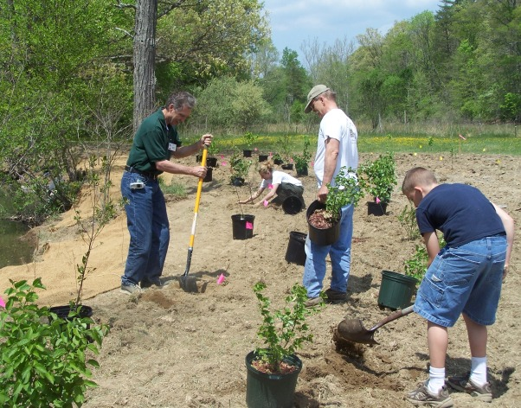
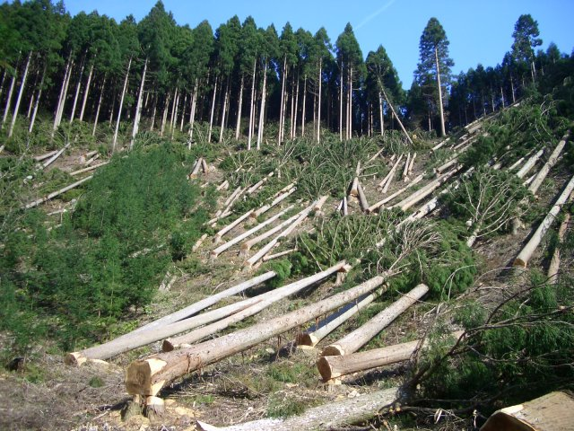
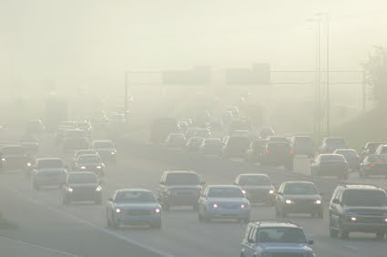
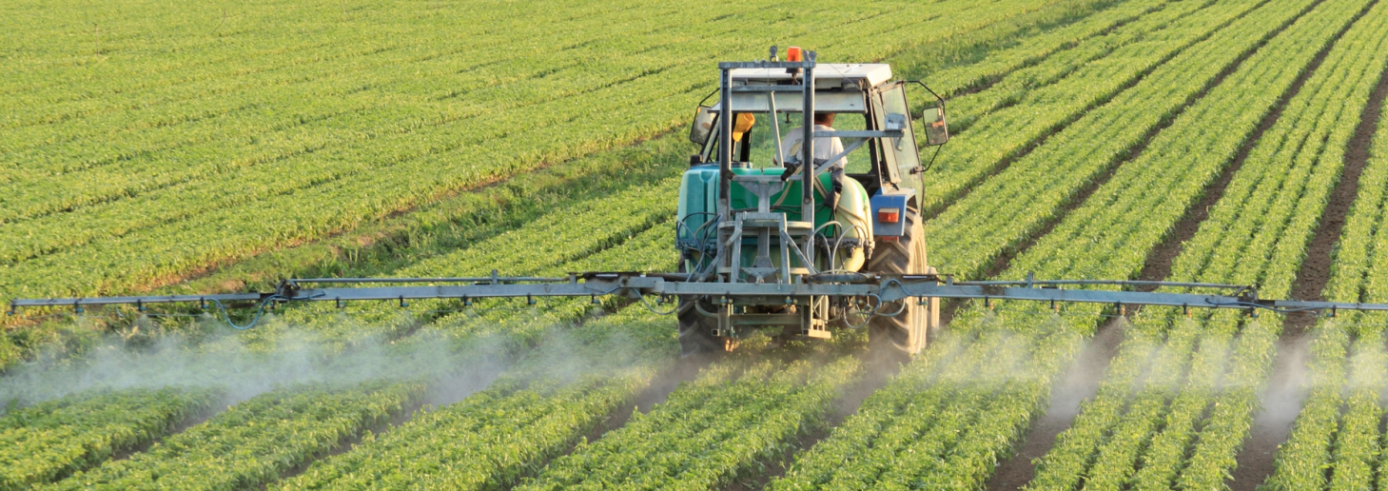
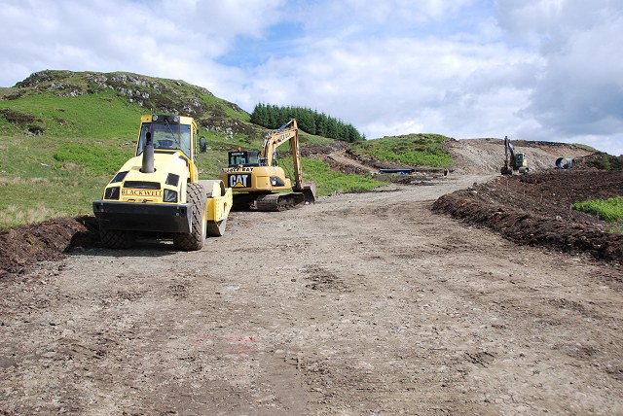
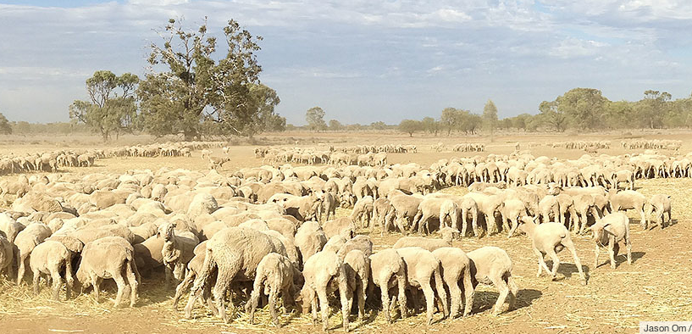
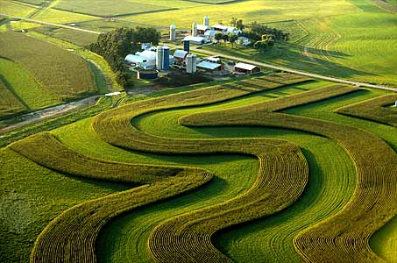
Human Impact
Ms. Edwards

Slide 2
Human activity can have a positive or a negative impact on the surface of our Earth.

Slide 3
Essential Question: How does human activity affect the Earth’s surface?

Slide 4
Standards
S6E5i. Explain the effects of human activity on the erosion of the earth’s surface.
S6E5j. Describe methods for conserving natural resources such as water, soil, and air.

Slide 5
What are some ways that humans negatively impact the Earth’s surface?

Slide 6
We are going to examine human impact on the Earth’s surface in three areas: Water, Soil, and Air

Slide 7
Use your Graphic Organizer to take Notes

Slide 8
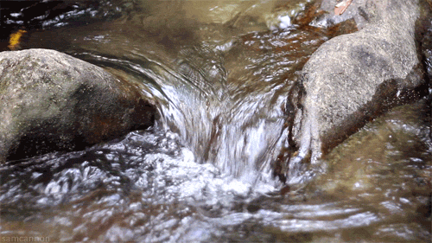
Human Impact on Water

Slide 9
Water that doesn’t soak into the ground or evaporate, but flows across the Earth’s surface is called runoff.
Water and Human Impact
Runoff can cause significant erosion to the Earth’s surface

Slide 10
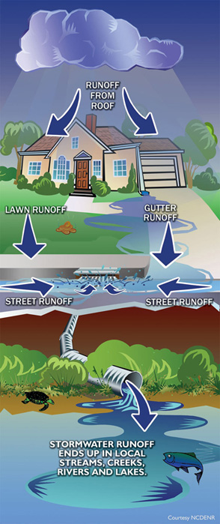
Runoff

Slide 11
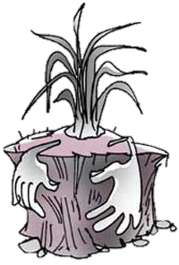
Plants and their roots (vegetation) help prevent soil from being carried away.
Water and Human Impact

Slide 12
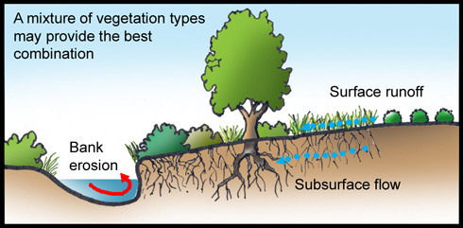
Plants Prevent Erosion

Slide 13
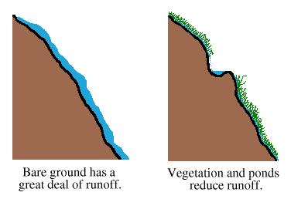
Water and Human Impact
Cutting down vegetation causes or increases runoff and erosion.

Slide 14
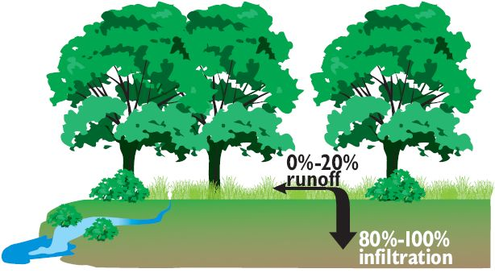
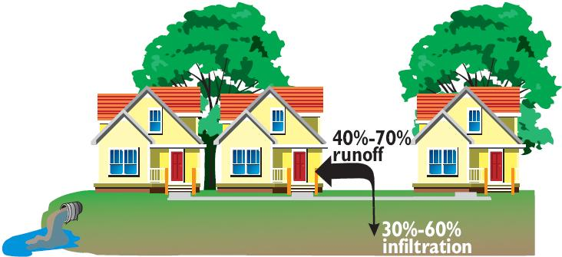
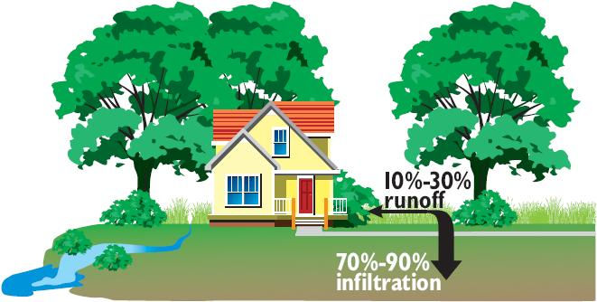

Slide 15
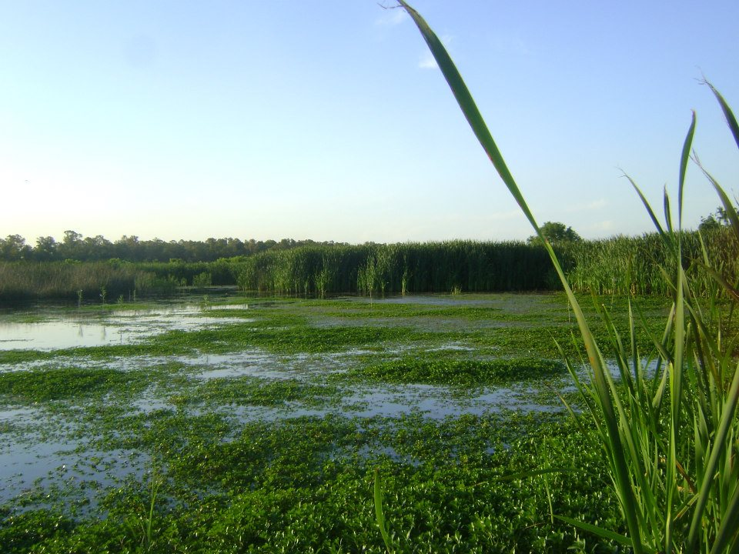
Wetlands

Slide 16
Wetlands
Protect water quality by trapping sediment and other pollutants that can get in the water
Provide flood protection because they act like a sponge holding excess runoff after a storm
Protect shorelines from erosion

Slide 17
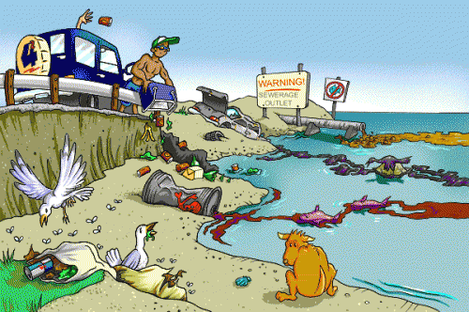
Water Pollution
All organisms need water. Polluted water can cause disease or bring death to many living things.

Slide 18
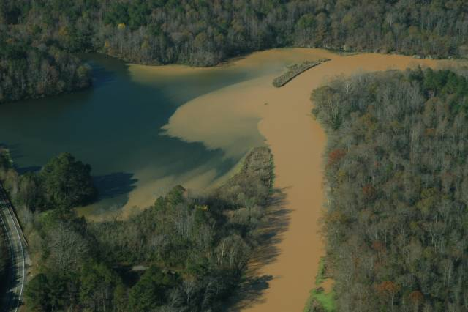
A main source of water pollution is sediment. The sediment makes water cloudy and blocks sunlight for underwater plants.

Slide 19
Water Pollution
Human activities can increase the amount of sediment in rivers, lakes, and oceans.
Sediments can be carried from farm fields, construction sites, cleared forests, land used for livestock, etc.

Slide 20
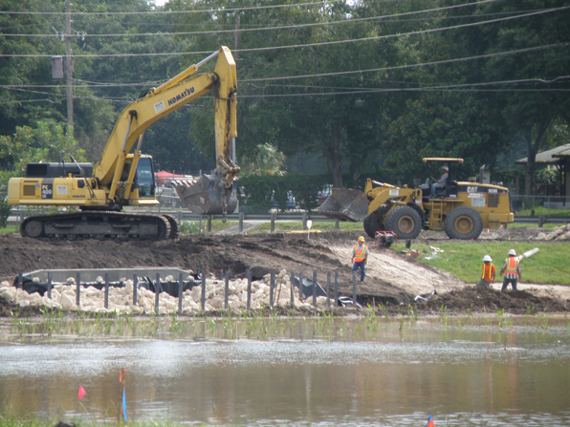
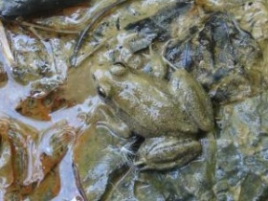
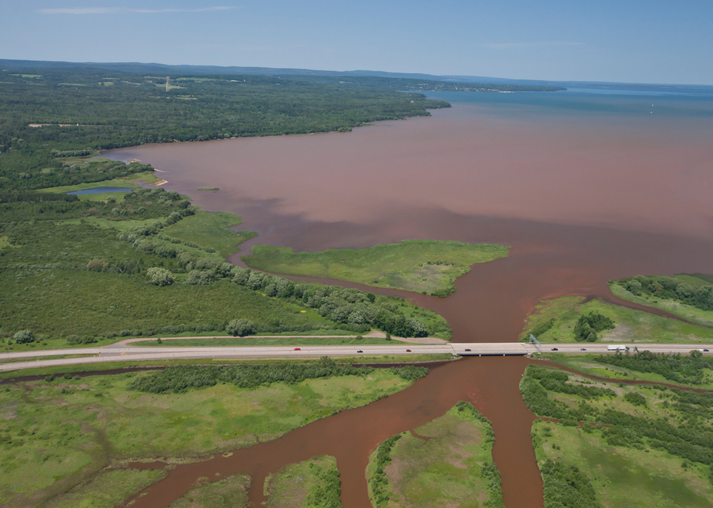
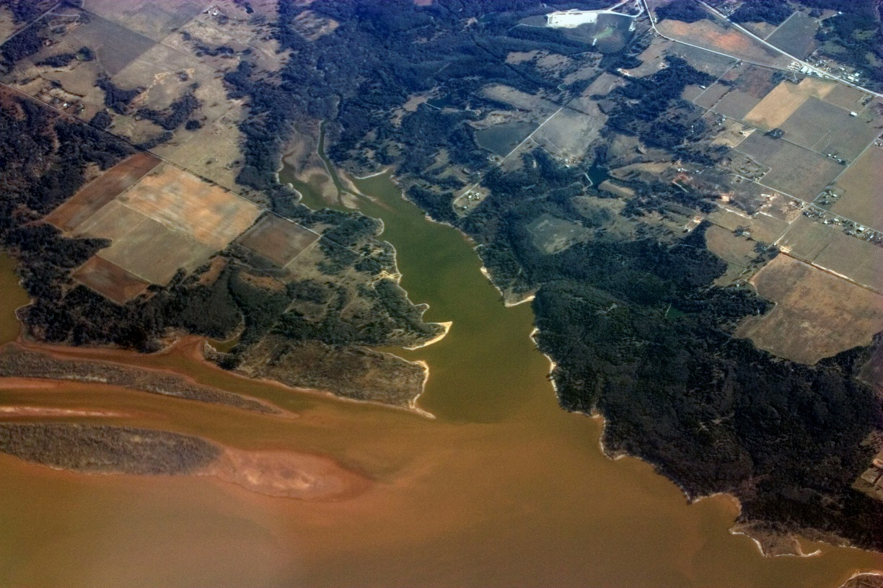

Slide 21
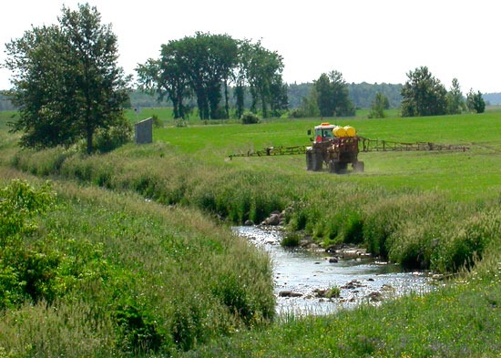
Water Pollution
Farmers and home owners use Pesticides to kill pests which can run off into water.

Slide 22
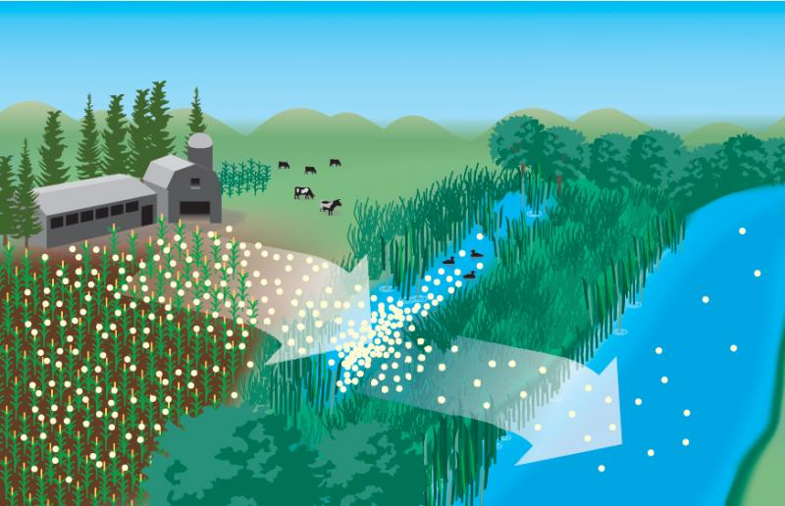
Water Pollution
Fertilizers are used to help plants grow. Rain washes away some of the fertilizer into ponds, rivers, and streams. These fertilizers harm organisms.

Slide 23
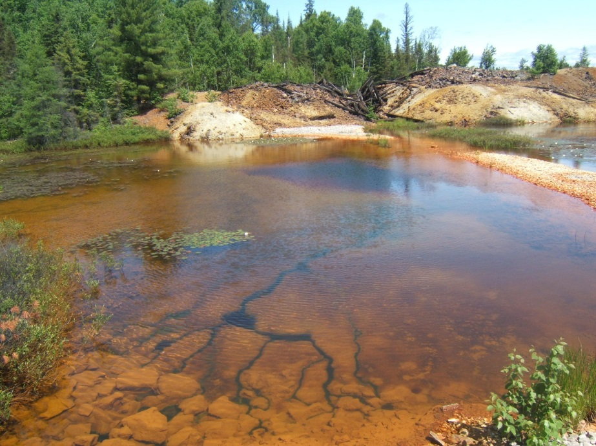
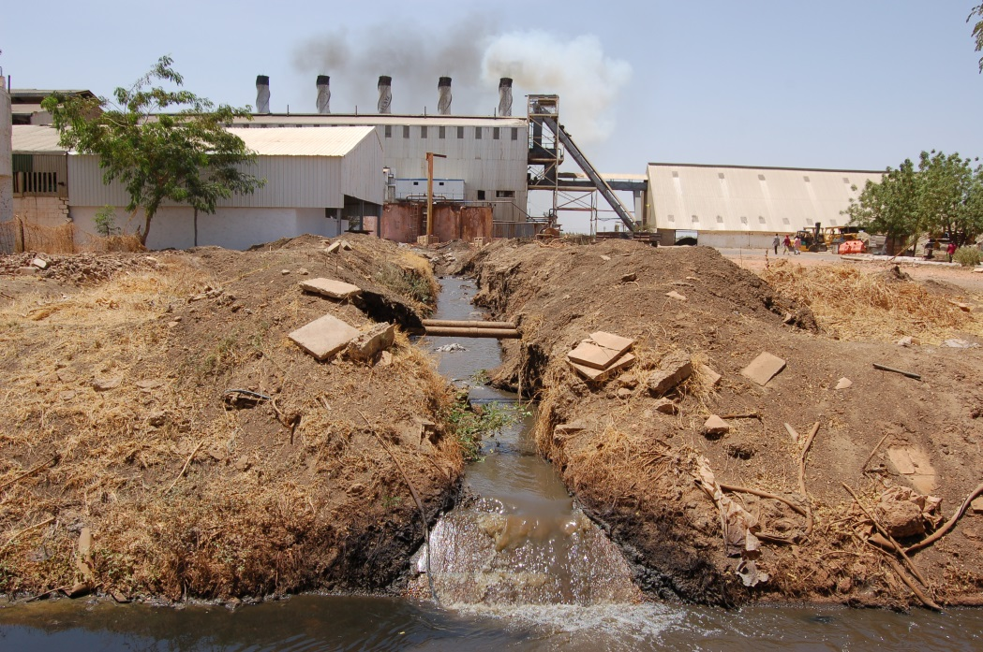
Water Pollution
Metals and other substances released by mining and manufacturing can pollute water for many years.

Slide 24
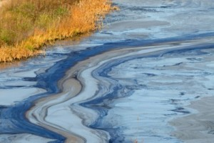
Water Pollution
Oil and gasoline can run off roads and parking lots into water sources when it rains.

Slide 25
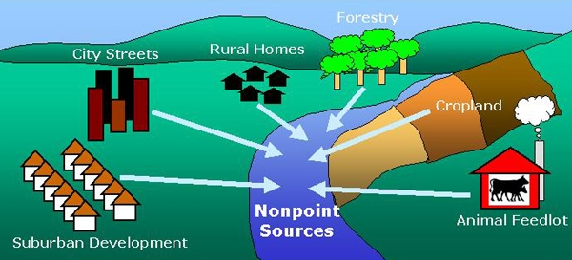
Water Pollution

Slide 26
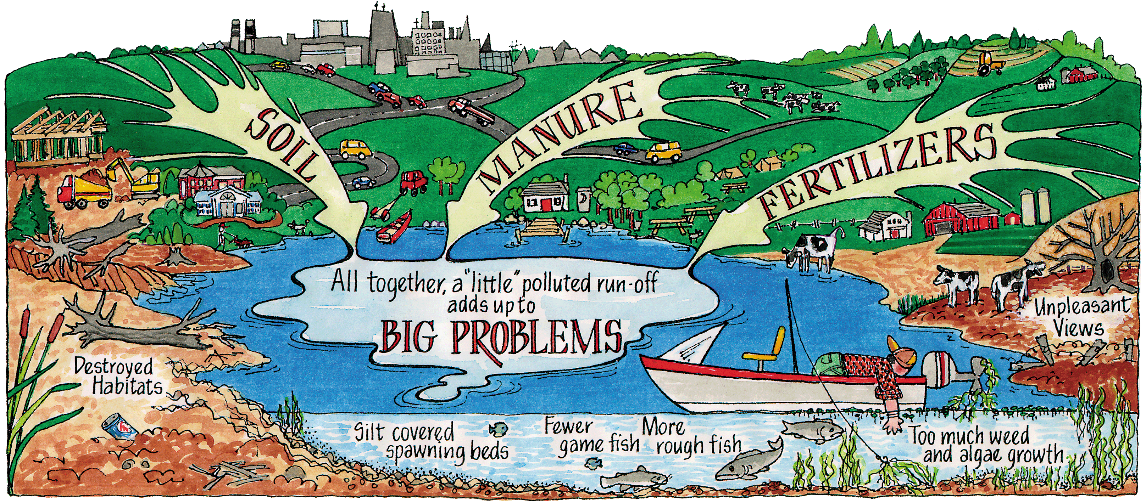
Nature is Speaking

Slide 27
Conservation
What is conservation?
The action of protecting or preserving something

Slide 28
Why is Conversation important?
The Earth’s resources can be reduced or used up if humans don’t use conservation strategies.

Slide 29
Conservation
What are some ways to conserve water?

Slide 30
Water Conservation
Reduce water pollution by treating (cleaning) water before it enters a stream, lake, or river.
Dispose of chemicals properly so they do not make it to water sources
Reduce the use of water
Protect wetlands and forests which help water quality and protect from erosion

Slide 31
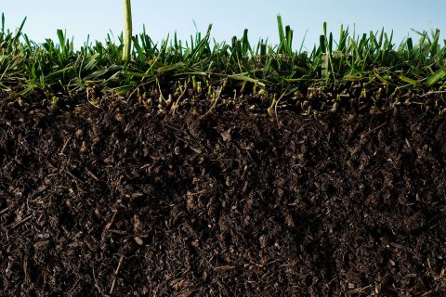
Human Impact on Soil

Slide 32
Human activities can increase soil erosion which washes away the nutrients that make soil fertile

Slide 33
Human Activities that Increase Soil Erosion:
Developing land for agriculture
Cutting down forests (deforestation) for logging or land development (business, industry, homes, etc.)
Overgrazing by cattle or livestock

Slide 34
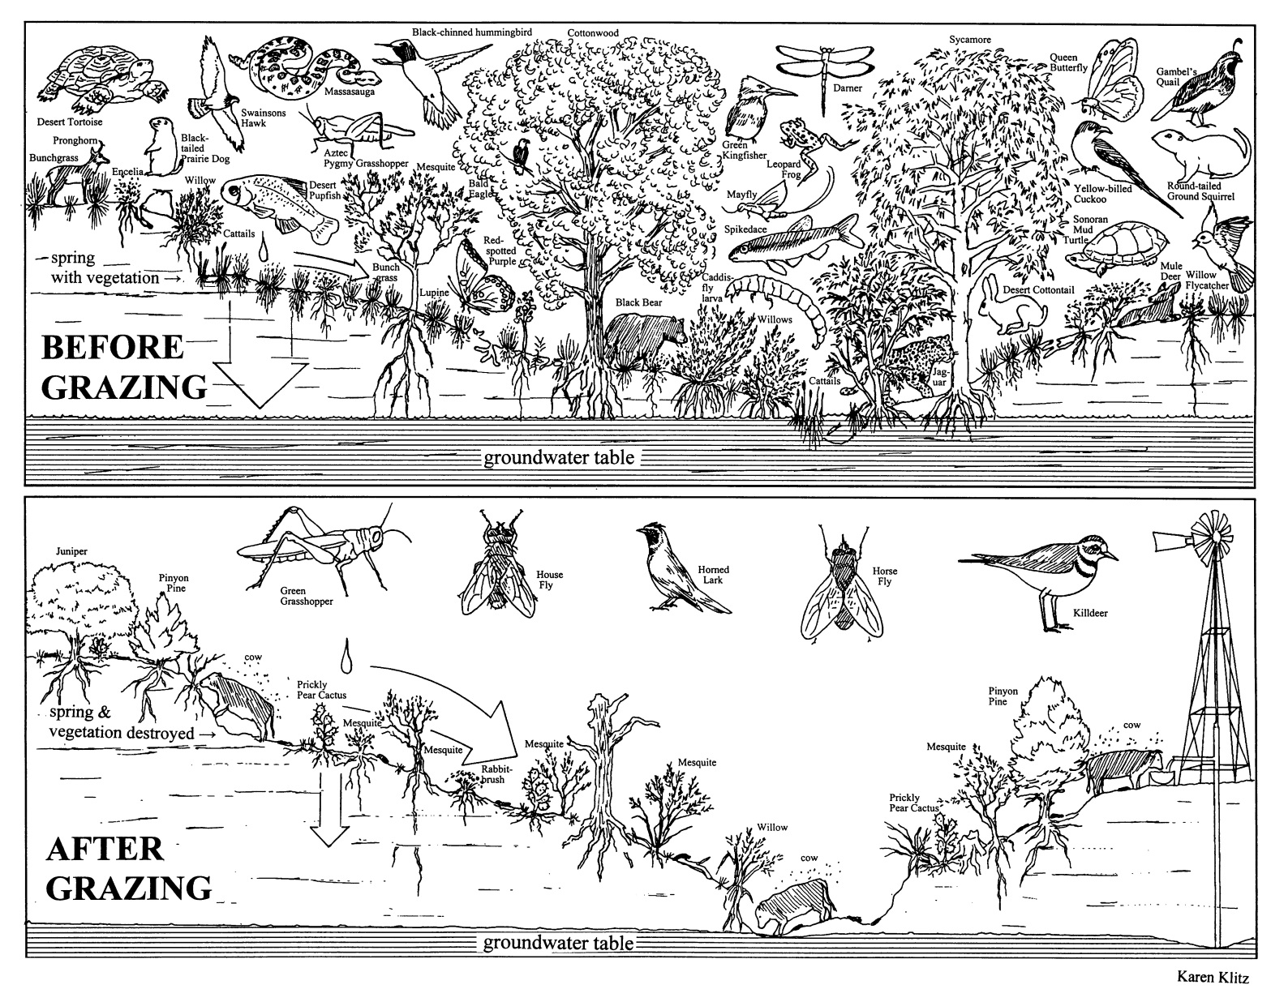
How does overgrazing impact the soil?

Slide 35
Human activities can also increase pollutants that get into soil.

Slide 36
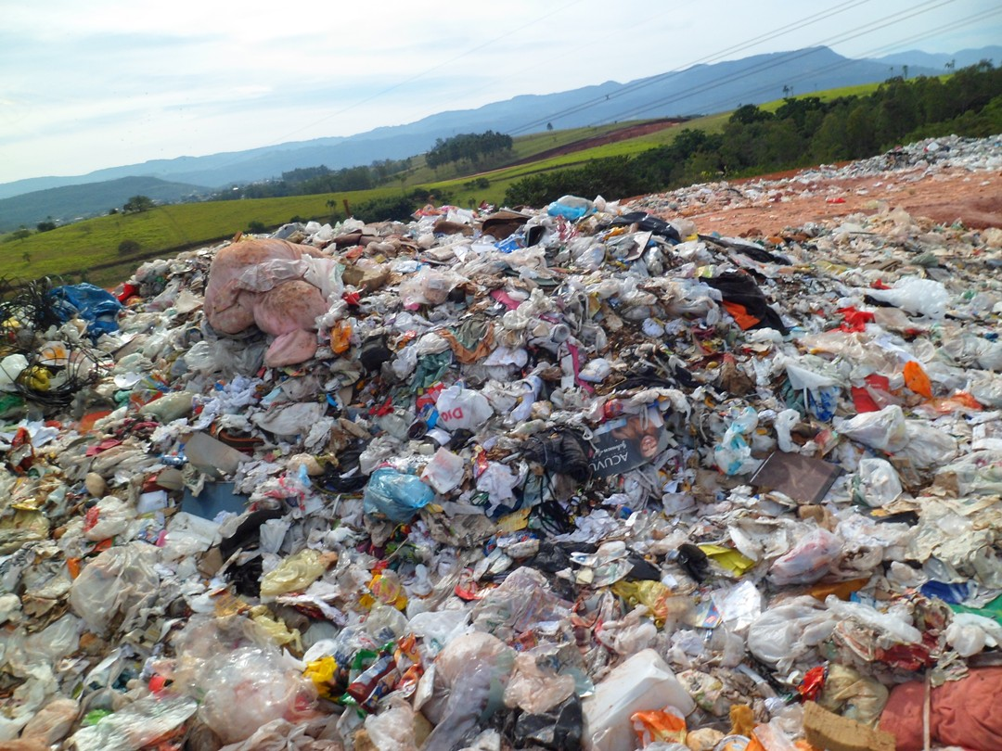
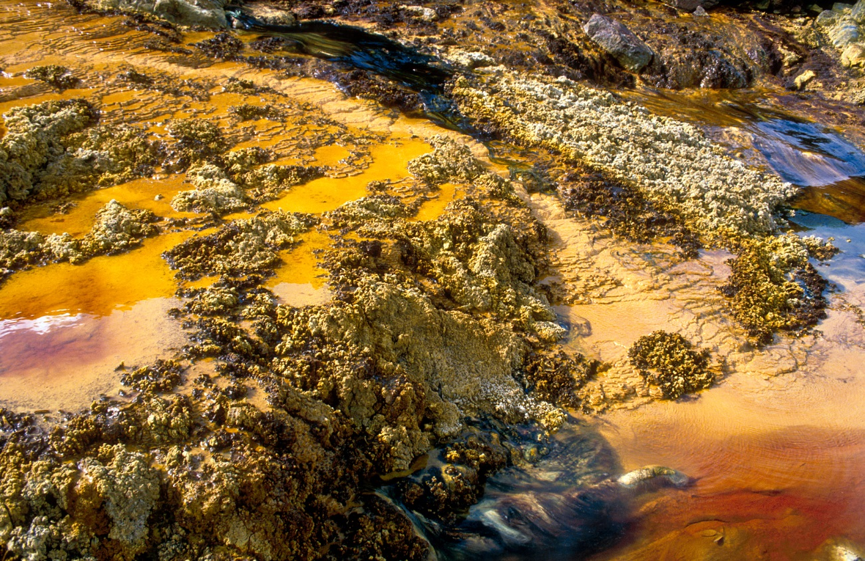
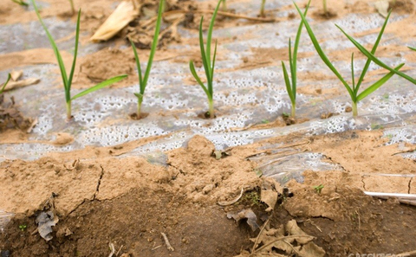
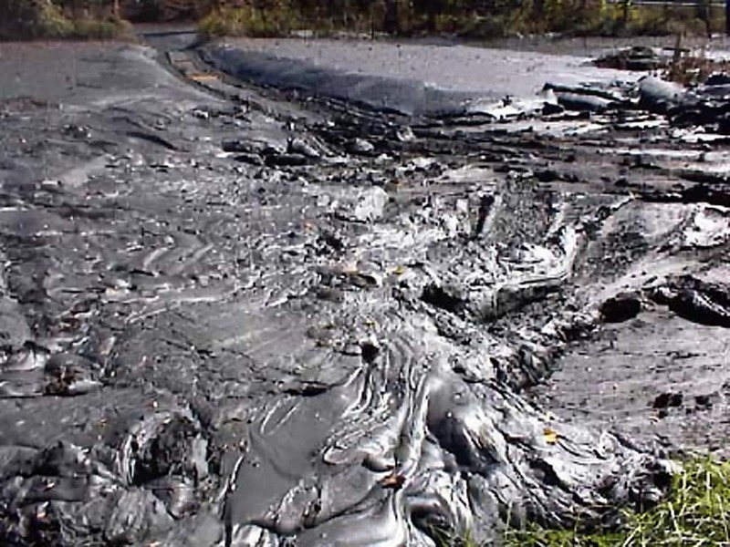

Slide 37
Soil Conservation

Slide 38
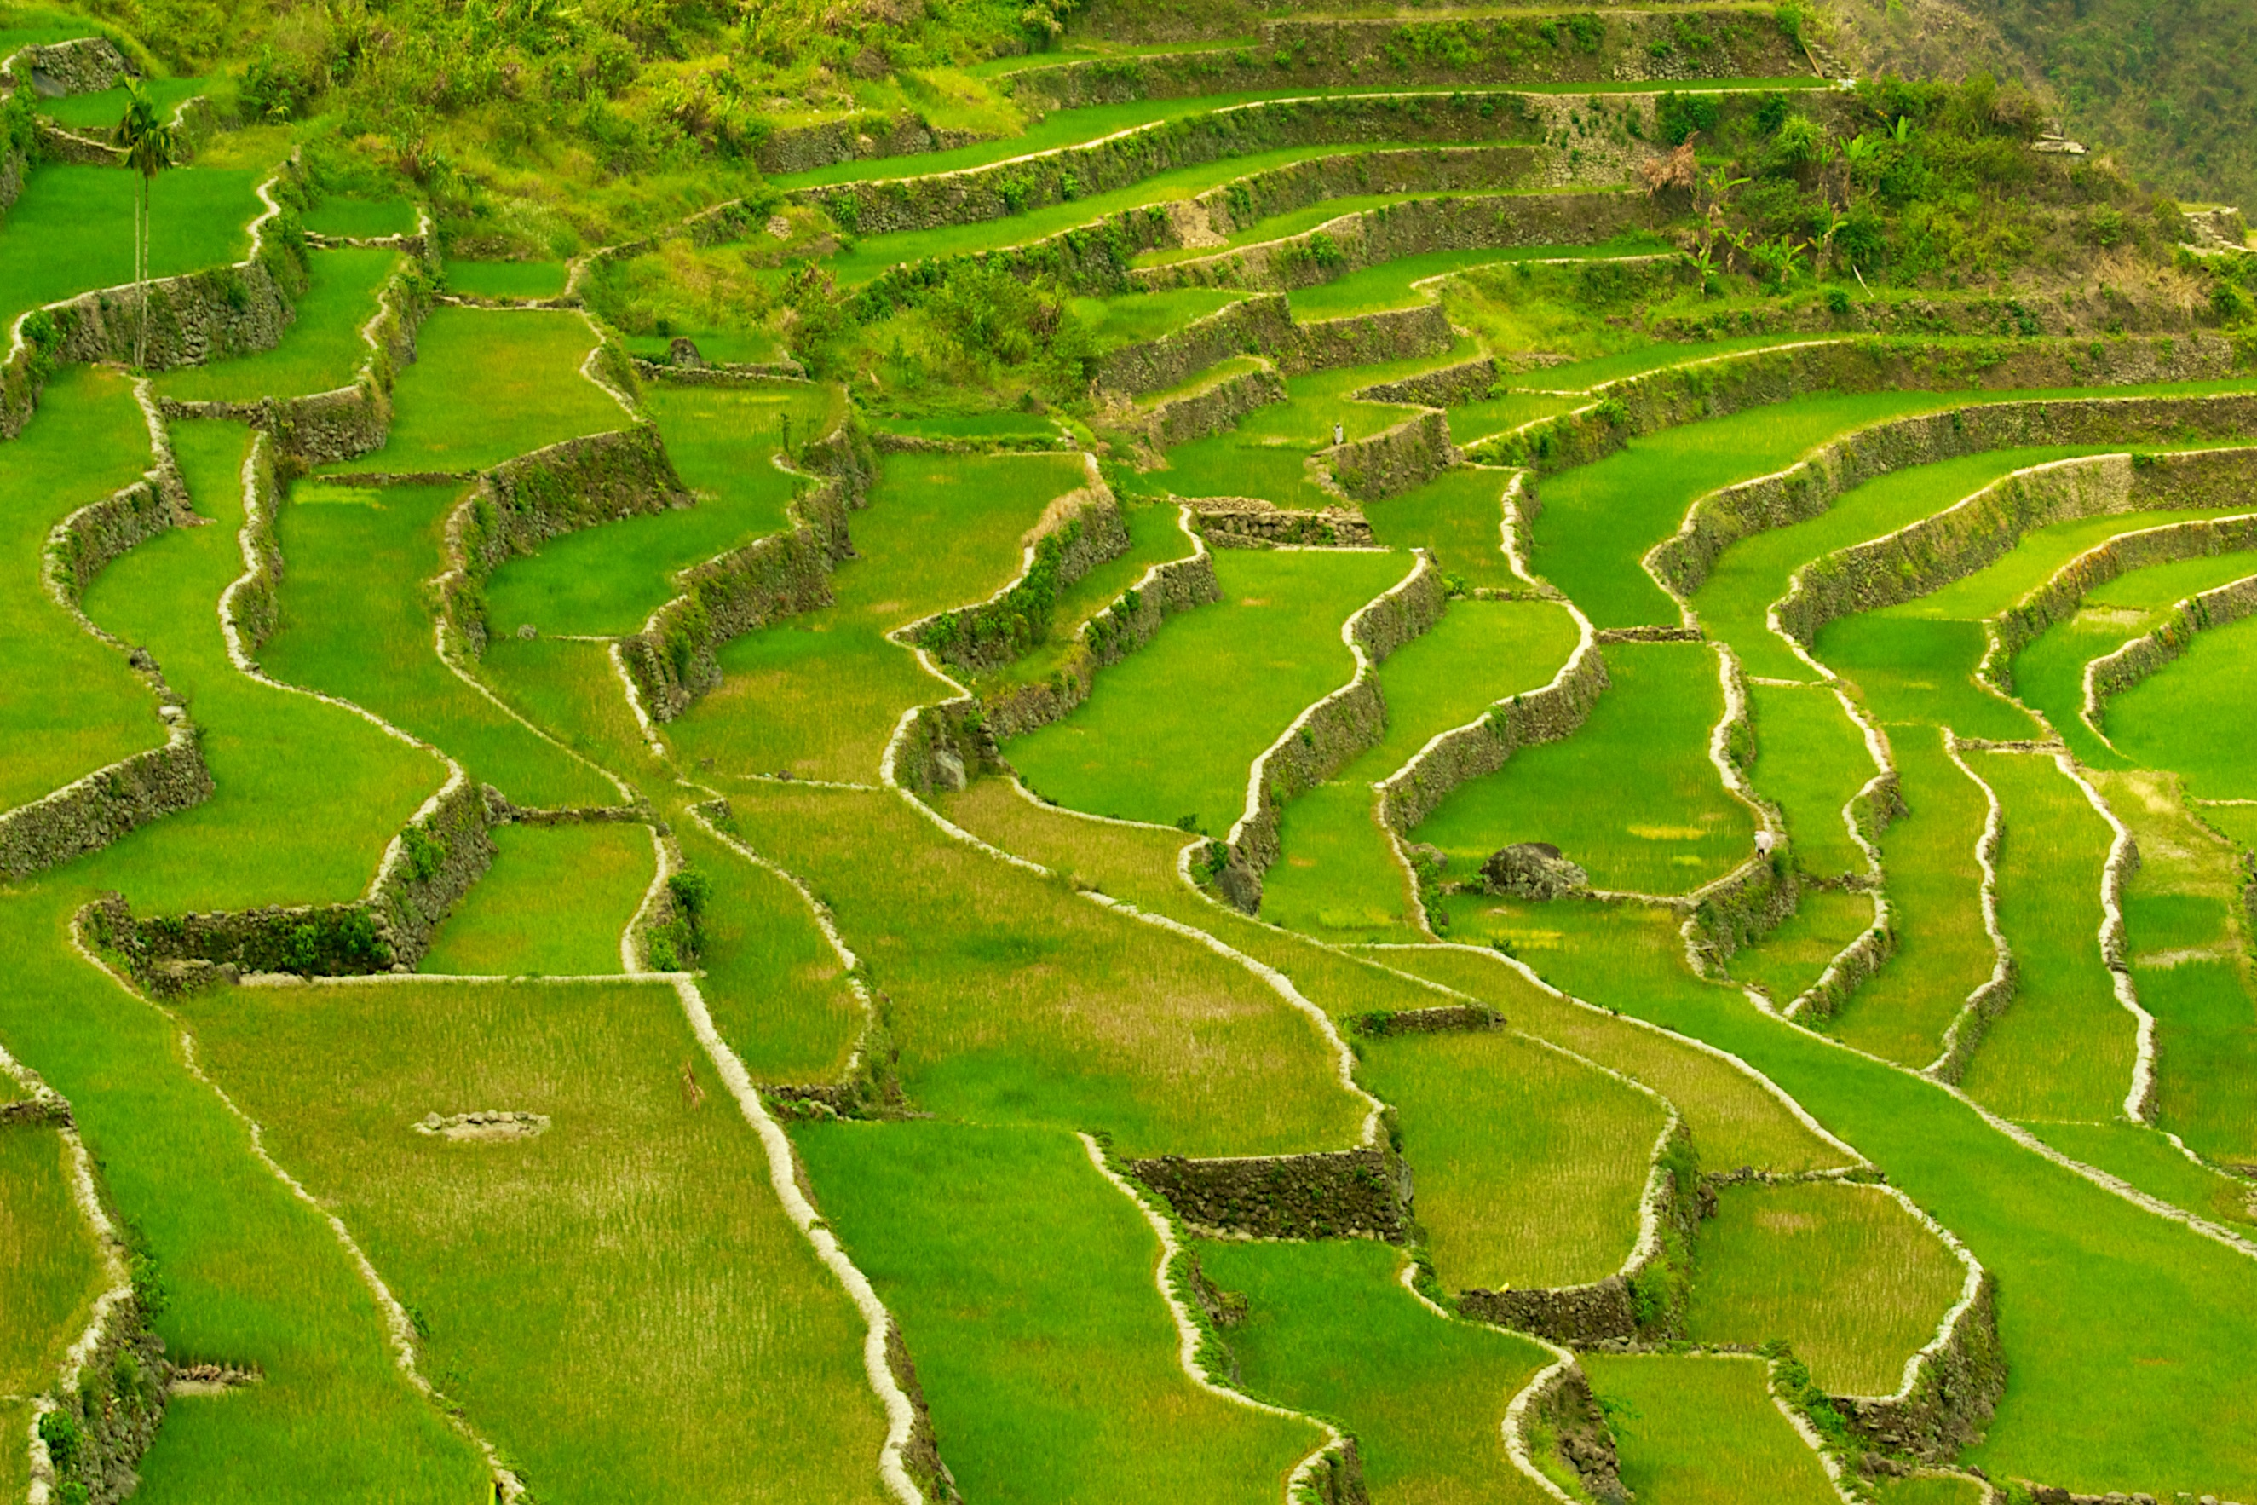
Terracing: make sloping land into a number of level flat areas resembling a series of steps.

Slide 39
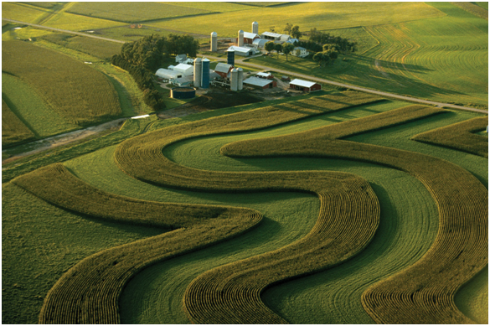
Contour Plowing: plowing that follows the curve of the land to slow water flow and save rich topsoil

Slide 40
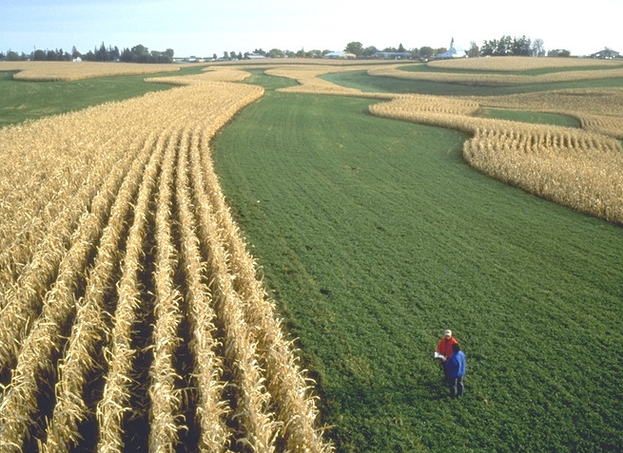
Strip Planting: alternates strips of plants to reduce erosion by creating natural dams for water

Slide 41
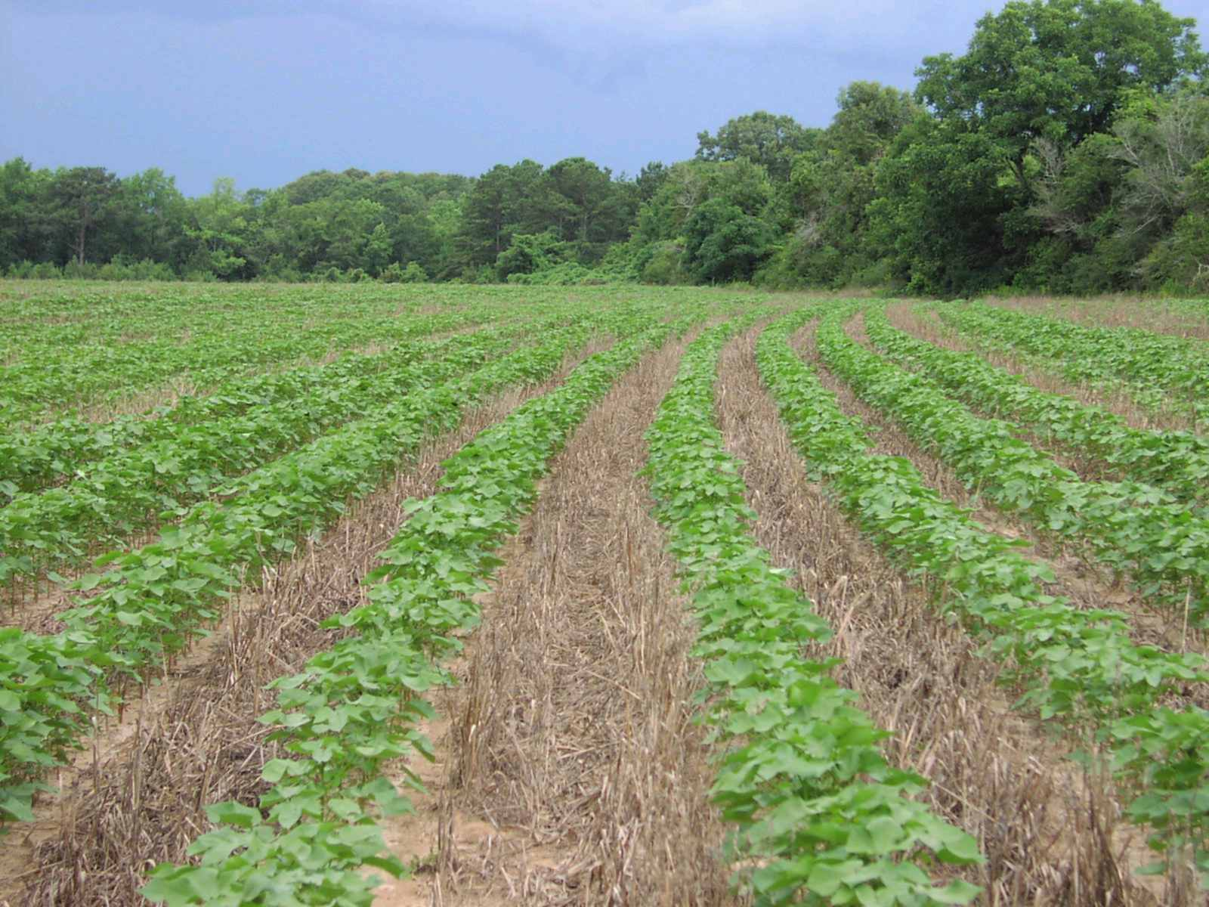
No-Till Farming: way of growing plants from year to year without disturbing the soil

Slide 42
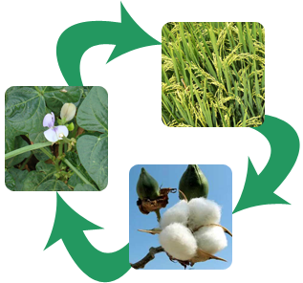
Crop Rotation: changing of crops in a sequence; it protects soil and decreases the population level of pests

Slide 43
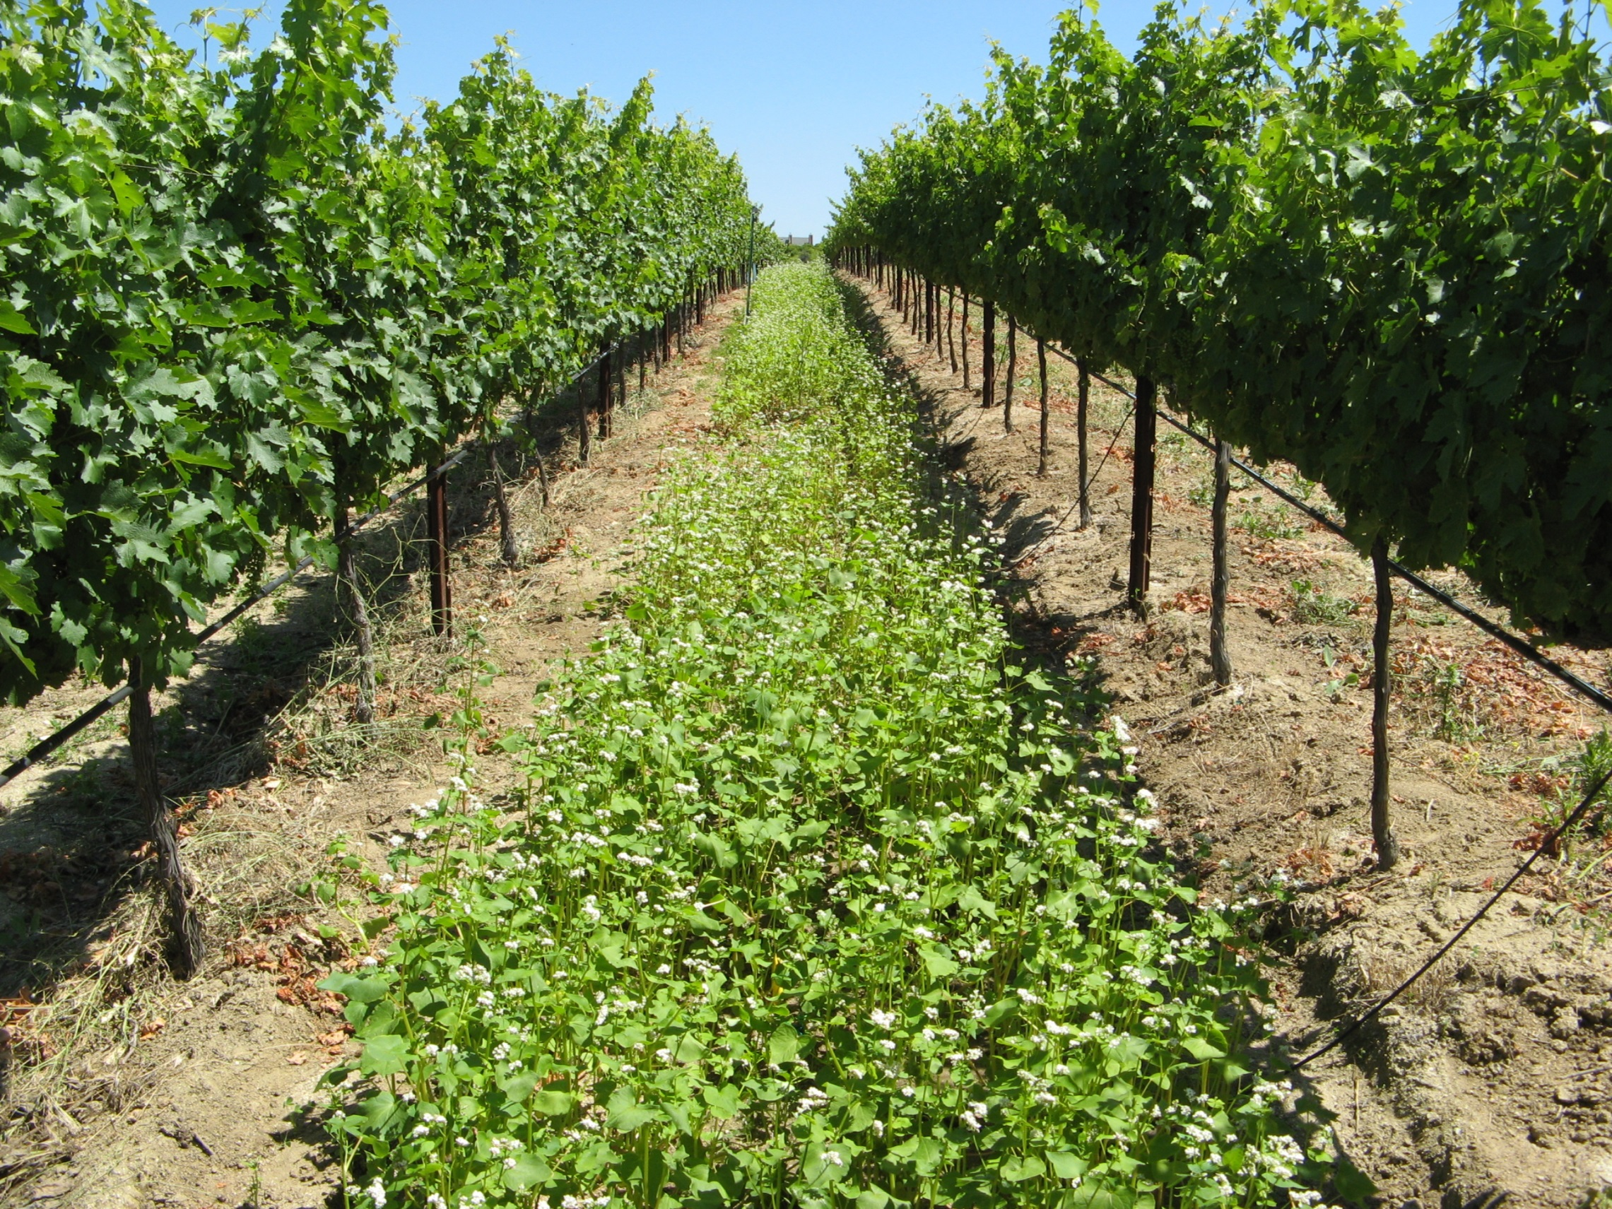
Cover Crop: crop planted mainly to manage soil erosion, soil fertility, soil quality, water, weeds, pests, and diseases

Slide 44
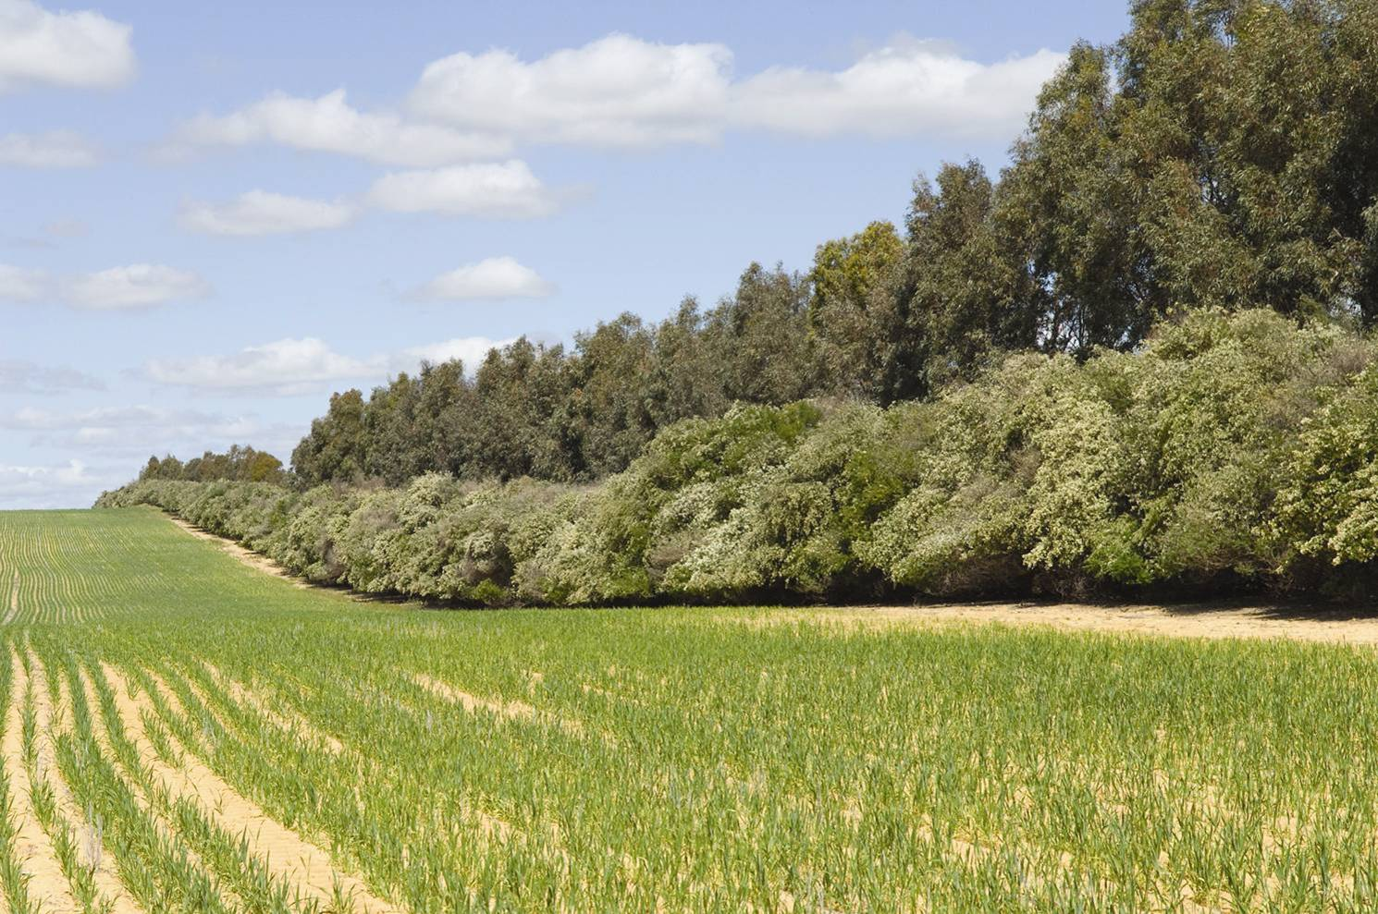
Wind Break: one or more rows of trees or shrubs planted to provide shelter from wind erosion

Slide 45
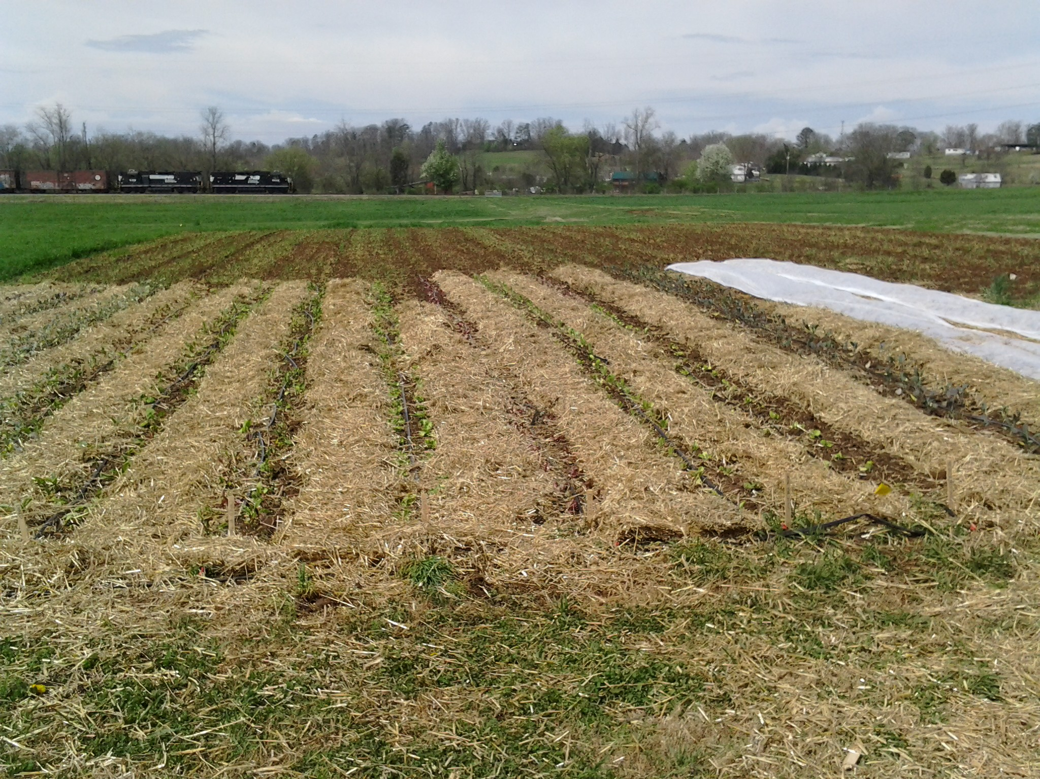
Mulching: a layer of material put on the soil’s surface to maintain moisture and health of the soil, and reduce weeds

Slide 46
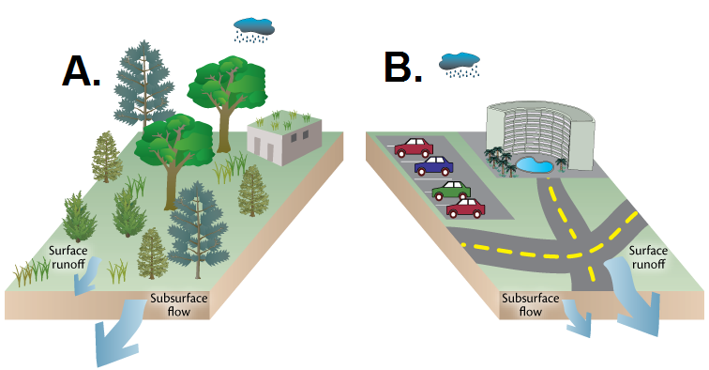
Which land use diagram below best illustrates soil conservation? Why?

Slide 47
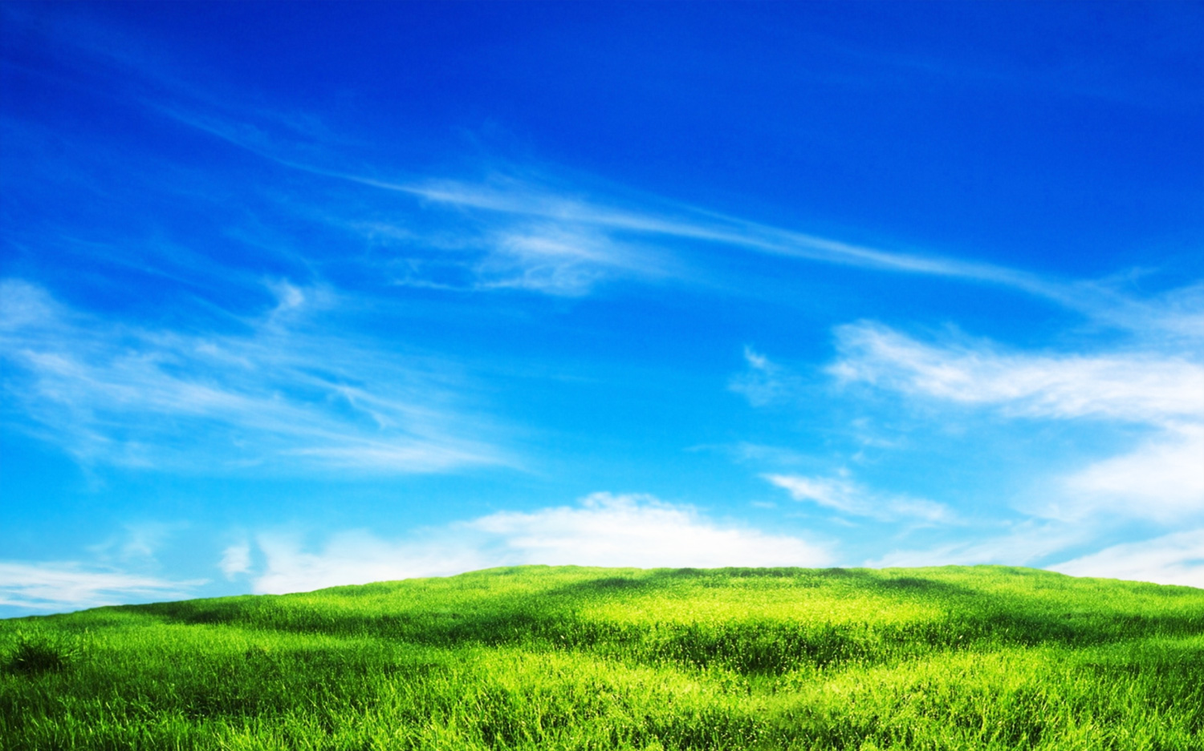
Human Impact on Air

Slide 48
What are some ways that humans can impact the air?

Slide 49
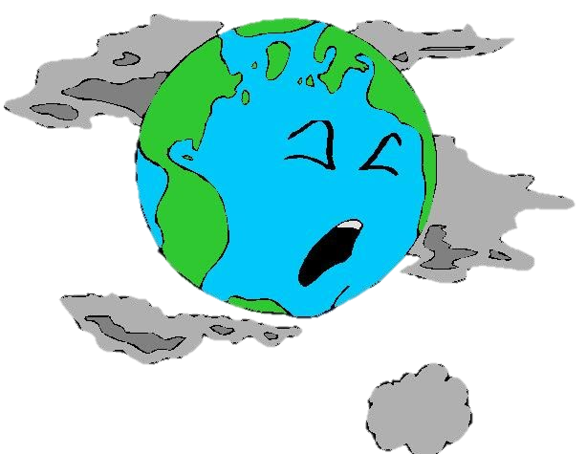
Air pollution is the introduction of harmful materials into the Earth’s atmosphere.

Slide 50
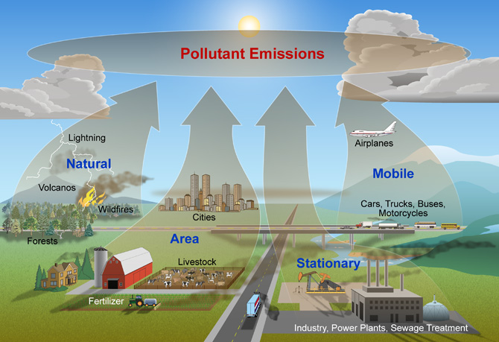
Causes of Air Pollution

Slide 51
Causes of Air Pollution
Emissions (release) of pollutants from cars, trucks, buses, factories, power plants, etc. that use fossil fuels
Dust from fields, construction sites, and mines contribute to air pollution
Natural disasters such as forest fires and volcano eruptions contribute to air pollution

Slide 52
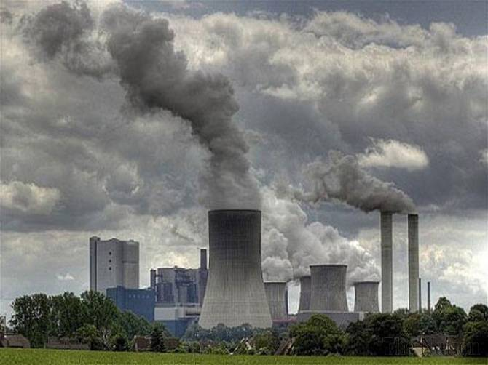
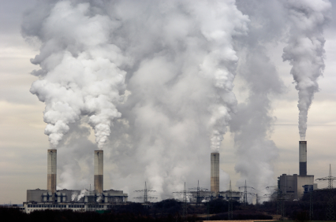
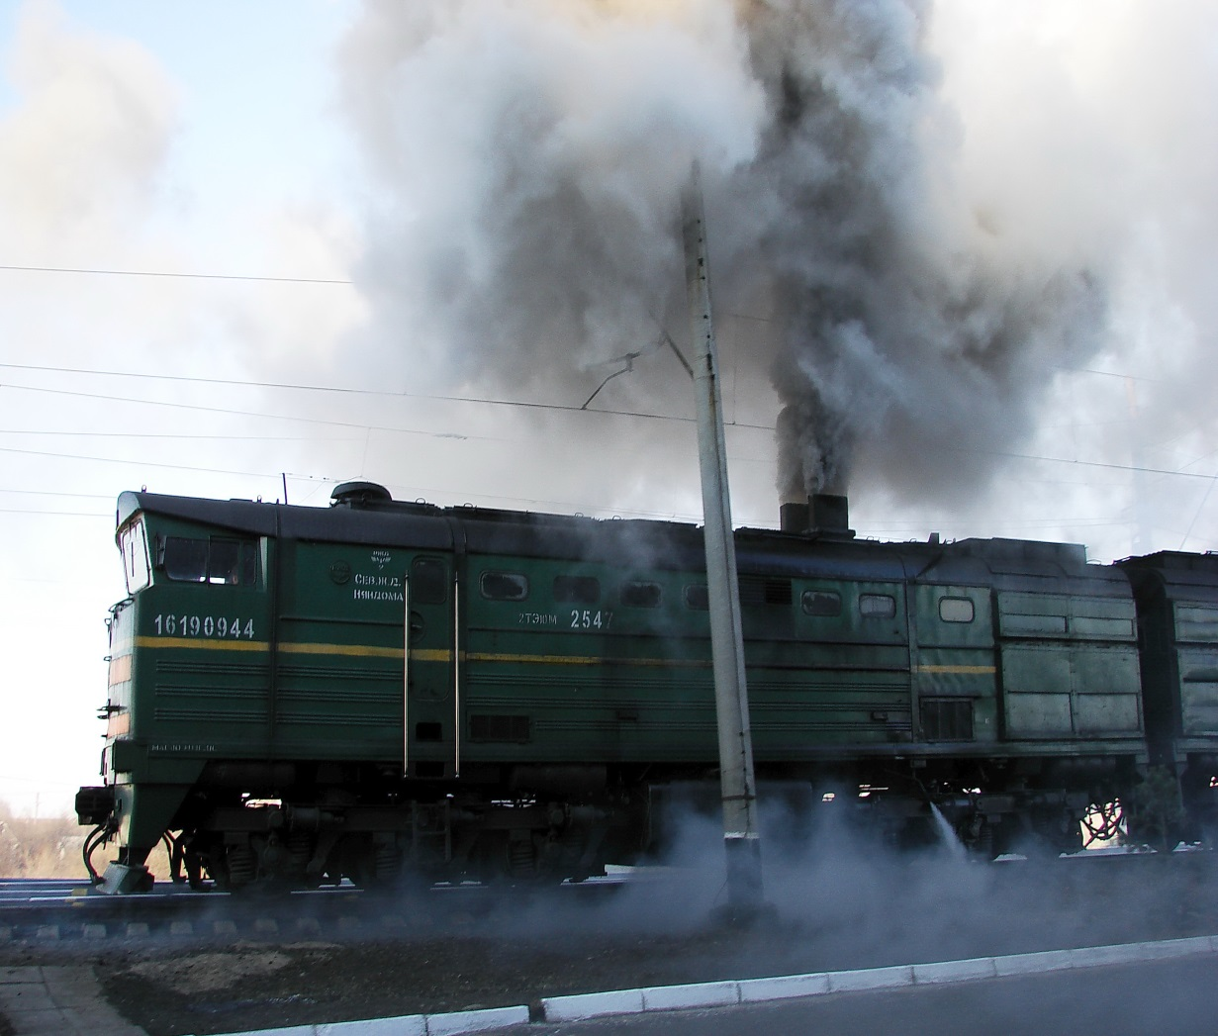
Emissions

Slide 53
Dust

Slide 54
Natural Disasters

Slide 55
Air Pollution does not have boundaries. It is carried by winds and deposited over long distances.

Slide 56
Effects of Air Pollution
Power plants, vehicles, and factories release pollutants that combine with moisture in the air to cause acid rain.
Acid rain contaminates drinking water, harms plants and animals, and damages rocks and buildings.

Slide 57
Effects of Air Population: Acid Rain

Slide 58
Effect of Acid Rain

Slide 59
Effect of Acid Rain

Slide 60
Effect of Acid Rain

Slide 61
Effects of Air Pollution
When fossil fuels (coal, oil, gas) are burned, they release pollutants and other greenhouse gases that are linked with global warming
These gases get trapped in the atmosphere (called the greenhouse effect) and can cause changes in climate

Slide 62
Effects of Air Pollution
Other pollutants that come from products such as aerosol cans, cooling systems, and refrigerator equipment (called CFC’s) cause “holes” in the ozone layer.
The ozone layer helps protect the earth from solar UV radiation (from the sun).

Slide 63
Effects of Air Pollution: Ozone Depletion

Slide 64
Air Conservation

Slide 65
Air Conservation
Reduce emissions from vehicles, factories, power plants (new technology and government regulations can help)
Reduce dust from construction sites, fields, and mining sites
Reduce the use of fossil fuels and products that release CFC’s
Use Renewable energy sources (wind and solar power)

Slide 66
Through conservation strategies, people can slow down the degradation of the environment and the depletion of non-renewable resources.

Slide 67
Reduce, Reuse, Recycle

Slide 68
Human Impact Summarizer

